Slide 1
FP BASED ESTIMATION
Function points are derived using an empirical relationship based on countable (direct) measures of software’s information domain and qualitative assessments of software complexity.
Information domain values are defined in the following manner:
  Number of external inputs (EIs).
  Number of external outputs (EOs).
  Number of external inquiries (EQs).
  Number of internal logical files (ILFs).
  Number of external interface files (EIFs).

Slide 2
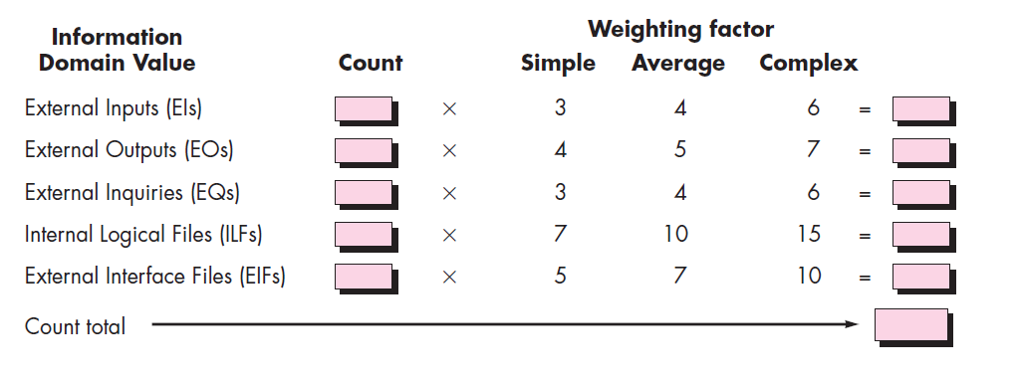

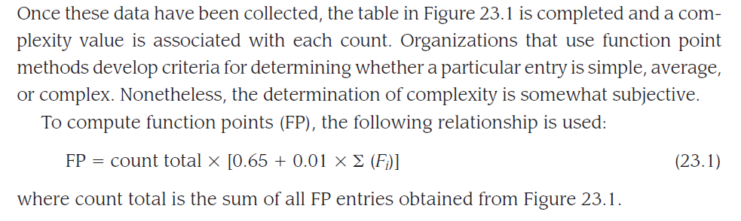
Function Point Metrics

Slide 3
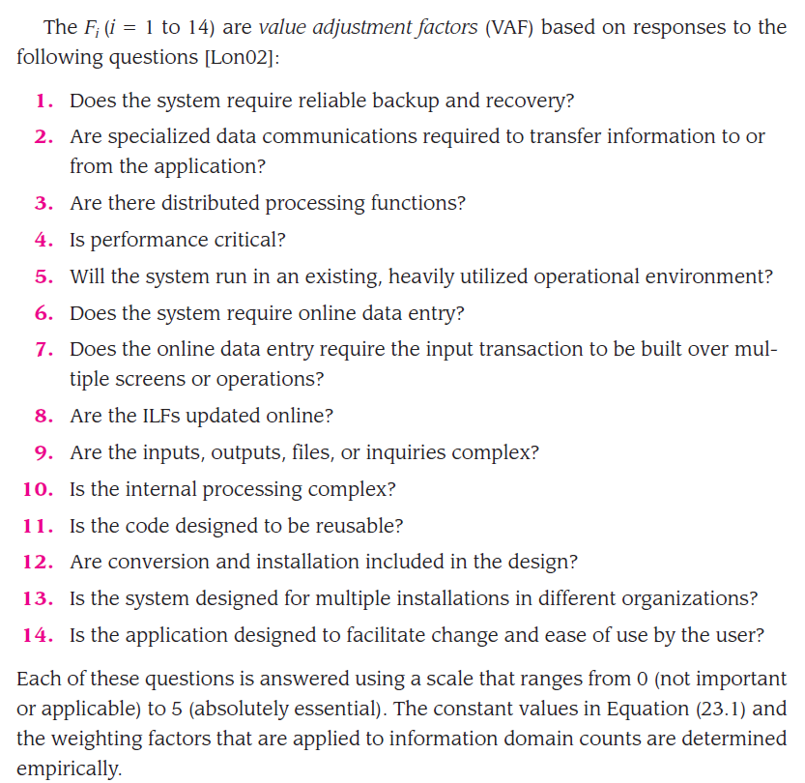

Slide 4
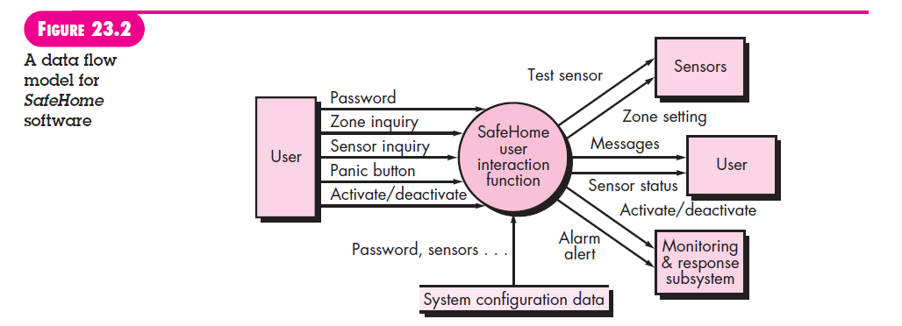
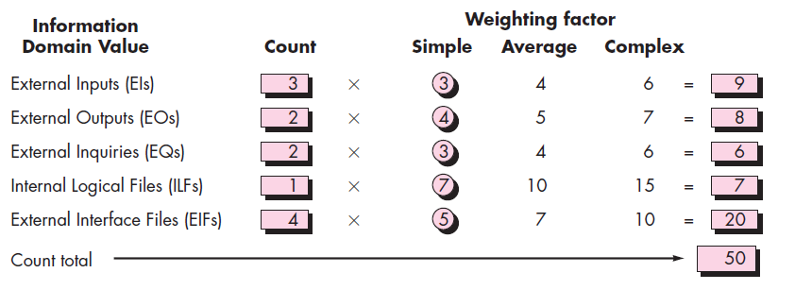
Example : FP based Estimation

Slide 5
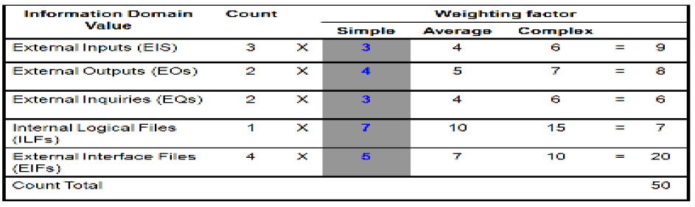
Example for FP based estimation
Once the information data have been collected, calculate the FP values by associating a complexity value with each count as shown below
To compute function points (FP), the following relationship is used:
▪ FPestimated = count-total * [0.65 + 0.01*Ʃ (Fi)]
where Fi (i = 1 to 14 are value adjustment factors) and count total is the sum of all FP entries obtained

Slide 6
For the given Safe Home software problem, we assume that Ʃ (Fi) is 46
FPestimated = 50 * [0.65 + 0.01*46] =56
The organizational average productivity for systems of this type is 6.5 FP/pm.
Based on a burdened labor rate of $8000 per month, the cost per FP is approximately $1230.
Based on the FP estimate and the historical productivity data, the total estimated project cost is $68,880 (56 * 1230) and the estimated effort is 9 person-months (56/6.5)

